Slide 1
SIMPLE CALCULATOR

Slide 2
INPUT:
The expected input is to enter the text expression and the text expression will be a floating point number or integer number . These are the inputs which are given for this simple calculator.
OUTPUT:
The output is expected to process the input given and return the result in the form of integer or floating point number.

Slide 3
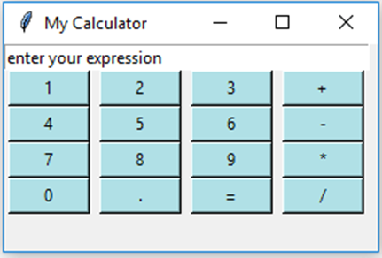
The expected output should be like:

Slide 4
LITERATURE SURVEY:
This program creates a GUI calculator with number buttons and specifics operation buttons like Addition, Subtraction, Multiplication and Division.
GUI windows can be generated using tkinter module.
Also to attain the expected output some pre defined function and user defined functions.

Slide 5
TOOLS:
Python idle 3.9.0 is going to be used to develop this simple calculator.
IDLE has two main window types, the Shell window and the Editor window. It is possible to have multiple editor windows simultaneously.

Slide 6
Features in python idle3.9.0:
coded in 100% pure Python, using tkinter GUI toolkit.
cross-platform: works mostly the same on Windows, Unix, and macOS.
Python shell window (interactive interpreter) with colorizing of code input, output, and error messages.
multi-window search within any window, replace within editor windows, and search through multiple files (grep).
debugger with persistent text editor with multiple undo, Python colorizing, smart indent, call tips, auto completion, and other features.
breakpoints, stepping, and viewing of global and local namespaces.
configuration, browsers, and other dialogs.

Slide 7
Tkinter module is used for GUI in python.
1)Tkinter module:
Tkinter is the standard GUI library for Python. Python when combined with Tkinter provides a fast and easy way to create GUI applications. Tkinter provides a powerful object-oriented interface to the Tk GUI toolkit.

Slide 8
2)Set variable:
In Python Tkinter - the ‘.set()’ method is used to set and change the value stored within a tkinter Variable - they are similar to Python variables.
They are strongly typed (you have to build an IntegerVar, FloatVar, StringVar, BooleanVar etc), and can only store the appropriate data in those variables.
The are changed using the set method .Syntax: <Variable>.set(value)
You can’t store None in a tkinter Variable
You can use the trace method on a tkinter Variable to ensure a function is called when the variable is changed .
You can (and in some cases must) attach tkinter variables to tkinter widgets to control the data that they display or capture.

Slide 9
Windows can be created using tk() function and title of the window can be created by using title().
3)WIDTH:
Width is used to set the size of the window or button. If specified width is greater than zero,it specifies how much space, in character widths, to allocate for the text label, if less than zero, specifies a minimum width. If zero or unspecified, the natural width of the text label is used.

Slide 10
4)Foreground and Background colour:
foreground | Specifies the text foreground color.
background | Specifies the cell or item background color.

Slide 11
5)Button:
The Button widget is used to add buttons in a Python application. These buttons can display text or images that convey the purpose of the buttons. You can attach a function or a method to a button which is called automatically when you click the button.
Syntax:
w = Button ( master, option=value, ... )

Slide 12
Syntax:
w = Button ( master, option=value, ... )
Parameters:
master − This represents the parent window.
options − Here is the list of most commonly used options for this widget. These options can be used as key-value pairs separated by commas.

Slide 13
BG: Normal background colour.
FG: Normal foreground colour.
WIDTH: Width of the button in letters.

Slide 14
Done by:
M.N.Tharani
CSE,Section 1
20cs056.

